Slide 1
Database Design Chat 009
The First Normal Form

Slide 2

Louis Davidson (drsql)
https://linktr.ee/drsql

Slide 3
First Normal Form
Everything we covered in Relational Form is true…
Data broken down to its lowest form
All rows must represent the same number of values (Sometimes referenced as “no repeating groups”)
Column Values are atomic
Continuing to shape data for the engine
This is good for data integrity and performance

Slide 4




Atomicity
Data represented in the most granular way without losing the original characteristics
Similar to context of physics as we know it in the 21st century
Break down H²0 into Hydrogen and Oxygen, no big deal
Break down Hydrogen it becomes a different sort of matter and you are going to need a new laboratory
This Photo by Unknown Author is licensed under CC BY-SA

Slide 5

First Normal Form Example 1
Requirement: Store information about books
What is wrong with this table?
Lots of books have > 1 Author.
BookISBN BookTitle BookPublisher Author
=========== ------------- --------------- -----------
111111111 Normalization Apress Louis 222222222 T-SQL Apress Michael 333333333 Indexing Microsoft Kim 444444444 DB Design Apress Jessica
, Louis
and Louis
& Louis
444444444-1 DB Design Apress Louis

Slide 6
Common Solution…
BookISBN BookTitle BookPublisher …
=========== ------------- ---------------
111111111 Normalization Apress … 222222222 T-SQL Apress … 333333333 Indexing Microsoft … 444444444 Design Apress …
Author1 Author2 Author3
----------- ----------- -----------
Louis Michael Kim Jessica Louis

Slide 7
Common Solution…
BookISBN BookTitle BookPublisher
=========== ------------- ---------------
111111111 Normalization Apress 222222222 T-SQL Apress
333333333 Indexing Microsoft 444444444 DMV Book Simple Talk
BookISBN Author
=========== =============
111111111 Louis 222222222 Michael 333333333 Kim 444444444 Jessica
ContributionType
----------------
Principal Author
Principal Author
Principal Author
Contributor
Principal Author
444444444 Louis

Slide 8
Correct Solution… Add tables for repeating values
BookISBN BookTitle BookPublisher
=========== ------------- ---------------
111111111 Normalization Apress 222222222 T-SQL Apress
333333333 Indexing Microsoft 444444444 DMV Book Simple Talk
BookISBN Author
=========== =============
111111111 Louis 222222222 Michael 333333333 Kim 444444444 Jessica
ContributionType
----------------
Principal Author
Principal Author
Principal Author
Contributor
Principal Author
444444444 Louis

Slide 9
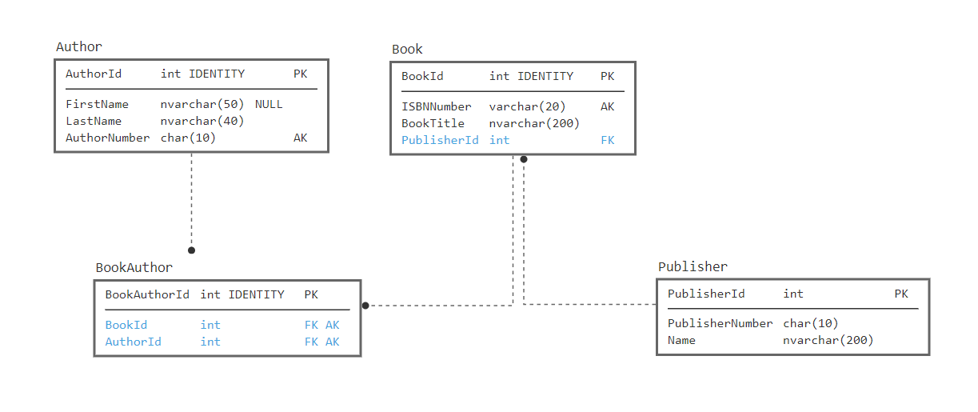
First Normal Form Example 1

Slide 10
Sad Reality Example
Email1 Email2 Email3
--------- --------- -----------
Email1Status Email1Type Email1PrivateFlag
------------ ------------ -------------------
Email2Status Email2Type Email2PrivateFlag
------------ ------------ -------------------
Email3Status Email3Type Email3PrivateFlag
------------ ------------ -------------------

Slide 11
First Normal Form Example 2
Requirement: Store users and their names
How would you search for someone with a last name of Nielsen? David? Davidson?
What if the name were more realistic with Suffix, Prefix, Middle names?
UserId UserName PersonName
=========== ~~~~~~~~~~~~~~ ---------------
1 Drsql Louis Davidson
2 Kekline Kevin Kline
3 Sqlmal Mala Mahadevan 4 PaulNielsen Paul Nielsen

Slide 12
Break columns into individual parts
UserId UserName PersonFirstName PersonLastName
=========== ~~~~~~~~~~~~~~ --------------- --------------
1 Drsql Louis Davidson
2 Kekline Kevin Kline
3 SqlMal Mala Mahadevan
4 PaulNielsen Paul Nielsen
This optimizes the most common search operations
It isn’t a “sin” to do partial searches on occasion, just don’t make it habitual:
I know the last name ended in “son” or “sen”
If you also commonly need the full name available, let the engine manage this using a calculated column:
PersonFullName AS CONCAT(PersonFirstName + ' ', PersonLastName)

Slide 13
Practically speaking
First Normal Form is performance oriented
Indexes work best on whole values
Or at least starting with the leftmost bits of a value
In a relational database, more tables are usually better than processing
It is easy to over think this rule:
FirstName: “Joe” could be put into a table with each character
Example: Letter: “J” Position: 1; Letter “o” Position: 2; Letter: “e” Position “3”

Slide 14
Until next time…
Correctness starts with proper structure
After achieving First Normal Form (as best as you can), your structure is starting to gel
Even data warehouses use First Normal Form
Indexes typically work with sorted data
This makes it essential to work with entire values

Slide 15
Questions?
If you have questions, you can:
Comment on YouTube
Email drsql@hotmail.com
Message me on Twitter at drsql
Contact me anywhere on https://linktr.ee/drsql
I may add an episode to discuss or reply directly

